Slide 1
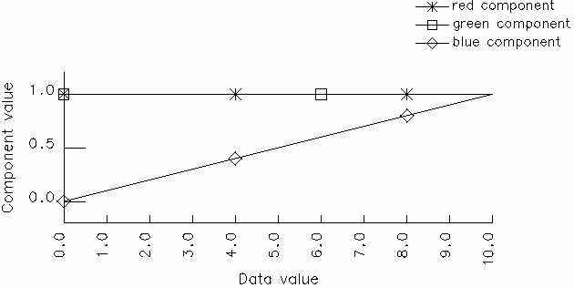
1 The graph below is a plot of the RGB components of a colour map, called Colour Map A, as it is applied to data in the range 0.0 – 10.0.
Describe the visual appearance of Colour Map A. [2]
Sketch the line it represents in RGB colour space. [3]

Slide 2
Sketch the line represented by Colour Map A in HSV colour space. Are these colours shades, tints or tones? [4]
In usage, it is found that Colour Map A can only distinguish four of the required ten data increments because its power to resolve values is poor. Explain why, referring both to the perceptual mechanisms involved and the physical basis of the displayed colour. [3]

Slide 3
Without changing the hue that is used, how in principle could you design a new colour map (B) that improves on the resolving power of Colour Map A? Describe the visual appearance of Colour Map B and add the line it represents to your HSV diagram. Are these new colours shades, tints or tones? [4]
If Colour Map B gives, say, a 50% improvement in resolving power compared with Colour Map A, propose a way to combine them in order to map all the data values uniquely. Plot the RGB components of this composite colour map in a graph similar to the one above. [4]

Slide 4
2 Compare and contrast the two broad aims of information visualization, namely the encoding of relation and the encoding of value, illustrating by reference to the following applications: a) The attribute explorer, as used for example to choose which house to buy. [2]
b) The cone tree disk visualizer. [2]
c) The scatterplot matrix, as used for example to investigate student performance in examinations. [2]

Slide 5
The following diagrams capture the steps I, II, III required to express the file structure on the left as a treemap. Assume all the files 1, 2, 3, 4 are the same size.
Explain these steps fully, stating a) Why the area of B is three times the area of A. [2]
b) Why the area of D is one-half the area of C. [2]

Slide 6
Which of the areas A, B, C, D, E, F are equal in size and why. [2]

Slide 7
Re-draw the completed treemap III so that the hierarchical relationships between folders and their constituent subfolders and files are obvious. [2]
1
2
3
4

Slide 8
Describe three different mouse interactions that a treemap implementation could support, in order to make it a useful disk file management tool. [3]
In the context of visualization, explain what is meant by pre-attentiveness. Explain why the treemap is not pre-attentive in respect of displaying file size, compared with, for example, a bar chart. [3]

Slide 9
3 Meteorologists are testing an automated rainfall measurement network on a flat piece of ground outside Hull. A regular grid of sensors has been positioned at known latitudes and longitudes, sending nightly totals to a monitoring station. Identify the independent and dependent variables of this application and comment on the continuous/dis-continuous nature of the data that results. [6]

Slide 10
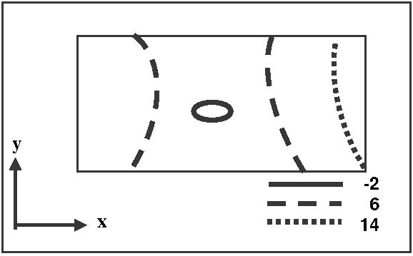
The table (not shown here) shows the rain that fell in one 24-hour period, in millimetres. On this day four of the sensors stayed dry (recorded zero rainfall), due to highly localised but very heavy showers, resulting in the plot below.
Name the visualization technique in use and say why the plot is inappropriate, even though the technique itself is suitable. [2]

Slide 11
Illustrate the cause of the problem, and how you might fix it, by drawing a line graph representing the row of data in bold in the table. [2]

Slide 12
Describe another way to visualize the data in the table, and contrast the insight conveyed by this new approach with the one above. Why would you preferably not use a surface view (rubbersheet) to denote the rainfall amounts, in spite of its apparent suitability for this type of data? [4]
The first system purchased is installed in the Pennine hills. Each sensor’s grid position therefore also has an altitude, measured as a spot height, associated with it. State, with reasons, whether altitude is an independent or a dependent variable in this context, and describe the visualization technique you would use to visualize it. [3]

Slide 13
Combine your answers in the previous slide to propose a visualization technique that encodes altitude and rainfall simultaneously. Give the name of this technique and sketch how a visualization that uses it might look. [3]

